Slide 1
Quality Management Systems
JAHID HASAN
ASSISTANT PROFESSOR
DEPT. OF IPE,SUST

Slide 2
What is quality?
Quality, simplistically, means that a product should meet its specification
This is problematical for software systems
  Tension between customer quality requirements (efficiency, reliability, etc.) and developer quality requirements (maintainability, reusability, etc.)
  Some quality requirements are difficult to specify in an unambiguous way
  Software specifications are usually incomplete and often inconsistent

Slide 3
Product quality attributes (1)
Attributes of good software (beyond delivering the required functionality):
Efficiency
  Software should not make wasteful use of system resources (disk and memory space, CPU time, etc.) and should present appropriate response times
Usability (ease of use)
  Software must be usable by the users for which it was designed
Dependability (reliability, availability, security, safety,…)
  Software must be trustworthy
Maintainability (ease of maintenance)
  Software must evolve to meet changing needs
  Software costs more to maintain than it does to develop. For systems with a long life, maintenance costs may be several times development costs
…

Slide 4
Product quality attributes (2)
Other quality attributes:
  Resilience
  Robustness
  Understandability
  Testability
  Adaptability
  Modularity
  Simplicity
  Portability
  Reusability
  Learnability

Slide 5
Main dimensions of dependability
Reliability - The probability of failure-free system operation over a specified time in a given environment for a given purpose
Availability - The probability that a system, at a point in time, will be operational and able to deliver the requested services
  It’s possibly to have high availability with low reliability if failures are repaired quickly
Safety - The system’s ability to operate, normally or abnormally, without danger of causing human injury or death and without damage to the system’s environment
Security – The system’s ability to protect itself from accidental or deliberate external attack

Slide 6
Process quality attributes
Process characteristic | Description
Understandability | To what extent is the process explicitly defined and how easy is it to understand the process definition?
Visibility | Do the process activities culminate in clear results so that the progress of the process is externally visible?
Supportability | To what extent can the process activities be supported by CASE tools?
Acceptability | Is the defined process acceptable to and usable by the engineers responsible for producing the software product?
Reliability | Is the process designed in such a way that process errors are avoided or trapped before they result in product errors?
Robustness | Can the process continue in spite of unexpected problems?
Maintainability | Can the process evolve to reflect changing organisational requirements or identified process improvements?
Rapidity | How fast can the process of delivering a system from a given specification be completed?

Slide 7
Quality of service
Some product-related services and their quality attributes
  User Training
  User Help
    Quick and useful response (avoid “Help does not Help”)
  Product repair and new versions deployment
    Quick and effective repair
    Conservation qualities:
      Things that worked well in the old version, continue to work well in the new version (regression tests are very important here), and don’t require new user training
      Installation of the new version doesn’t cause loss of user data (backward compatibility)
      Installation of the new version doesn’t require system down for too much time
    Progress qualities:
      Things that worked wrong or didn’t work at all in the old version, now work well in the new version, or new useful features have been added
Not focused in this presentation (more focused on product than service)

Slide 8
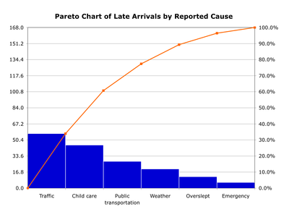
Pareto Chart
Graph of problem type vs. frequency
80/20 Rule – 80% of your problems will come from 20% of your work!
Frequency
Cumulative Percentage
Problem Type

Slide 9
Control Chart
Upper & Lower Control Limits (UCL & LCL)
  Set by quality goal i.e. 3σ
  Includes the normal and expected variation in the process
Specification Limits
  Contracted acceptable limit, usually outside UCL & LCL
Out of Control
  Data point falls outside of UCL/LCL
  Non-random data points i.e. “Rule of Seven”
Rule of Seven
  If you get seven points in a row on one side of the mean, seven points ascending, or seven points descending, the process is no longer random and it is out of control
  Originally adopted from a Ford quality manual
Assignable Change
  When the controller adjusts the process to bring the process back within process control limits

Slide 10
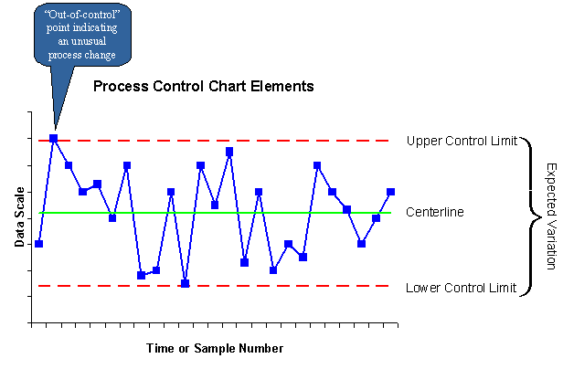
Control Charts
Specification Limit
(or Mean)
Specification Limit

Slide 11
Quality Management
Managing the quality of the software process and products

Slide 12
Quality management activities
Quality assurance
  Establish organisational procedures and standards for quality
Quality planning
  Select applicable procedures and standards for a particular project and modify these as required
Quality control
  Ensure that procedures and standards are followed by the software development team
Quality management should be separate from project management to ensure independence

Slide 13
Quality Management System
Definition:
A Quality Management System is a collection of policies, procedures, plans, resources, processes, practices, and the specification of responsibilities and authority of an organization designed to achieve product and service quality levels, customer satisfaction and company objectives.

Slide 14
Documentation:
Quality Policy – describes the organizations approach to quality
Quality Manual – Addresses each principle of the ISO 9000 Standard
Origin Of ISO 9000 Standards

Slide 15
Documentation –
Principles of the ISO 9000 Standard:
    Customer Focus – understand needs, meet requirements, exceed expectations
    Leadership – unity of purpose, organizational direction, empowerment, achieve objectives
    Involvement of People – fully involved employees, to benefit the organization
    Process Approach – accomplishments by processes, resources must be managed

Slide 16
Documentation - Principles of the ISO 9000 Standard – Cont. :
    System Approach to Management- processes are managed as a system
    Continual Improvement – permanently applied to the organization, its people, their processes, their systems and their products
    Factual Approach to Decision Making – decisions based on analysis of accurate, relevant and reliable data
    Mutually Beneficial Supplier relationships – organization and suppliers benefit from each other’s resources and knowledge

Slide 17
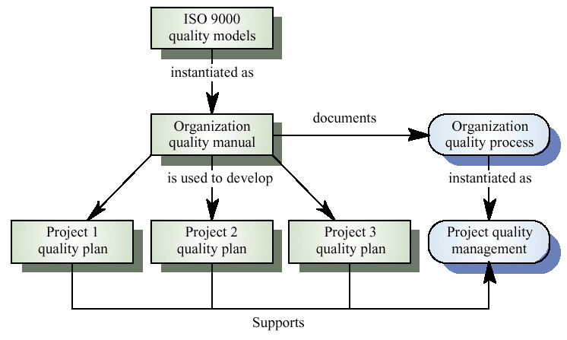
ISO 9000 and quality management

Slide 18
Documentation – Cont. :
  Organizational Chart
    Illustrates managements responsibility for operating the quality system
  Quality Procedures – may be referenced in this manual

Slide 19
Documentation – Cont. :
Quality Objectives
  Goals related to quality – must be in sync with the Quality Policy
  Assigned to organizational functions
  Tracked by Top Management
Quality Procedures
  Step by step what the company does to meet policy
  A procedure for each ISO principle
  Processes for procedures that affect quality

Slide 20
Documentation – Cont. :
Forms. Records etc.
  Proof of activities
  Documentation for auditors
  Ensure consistency of the firms operations
  Verify conformance to standards

Slide 21
ISO 9000 – International Standard
Definition:
A family of standards and guidelines, that sets the requirements, for the assurance of quality and management’s involvement in an organization. To ensure products and services are consistent with their intended purpose.
Achieve customer satisfaction
Continual improvement of performance and competitiveness
Continual improvement of processes, products and services
Comply with regulatory requirements

Slide 22
ISO 9000 – International Standard:
How ISO 9000 is applied
  Not required by government, up to management to follow
  May require suppliers to be compliant to standards
    Apply QMS to the operation
    Continually assess the effectiveness
    Make changes for improvement
    Conduct audits
    Submit to third party audits
    Submit to a new registration every 3 years

Slide 23
ISO 9000 – International Standard:
Authority of registration
  Awarded by a registrar or certification bodies
  Accredited by accreditations bodies
  International Accreditation Forum (IAF)
  IAF takes authority from Article 6 of the WTO’s 1994 Agreement on Technical Barriers to Trade

Slide 24
ISO 9000 – International Standard:
Registration statistics
  December 2008 -- 100,000,00 certificates were held in 179 countries
    China 180,107
    Italy 117,437
    Japan 89,375
    United States 49,820
  China becoming a industrial Superpower building quality recognition
  Service sector now evaluated for suitability, effectiveness, performance and quality

Slide 25
ISO 9000 – International Standard:
Organizational Registration
  More credibility in world marketplace
  Conforming organizational steps
    Develop a quality manual that gives assurance of quality products and services
    Document procedures of how everything will be operated
    Secure top management’s commitment to the QMS and continual improvement
    Customer requirements determined and met
    If registering they must hire an accredited registrar
    Conduct its own internal audits
    External audits from accredited registrar

Slide 26
ISO 9000 – International Standard:
Customer Benefits
  Meet requirements
  Competitive prices
  Increased confidence in products
Expectation of quality

Slide 27
Summary:
  ISO 9000 and TQM are not fully interchangeable
  ISO 9000 is compatible and can be a subset of TQM
  Vastly different origins
    ISO 9000 was developed to harmonize national and international standards
    Total Quality came from Japan as a way for them to compete in the international marketplace
  The aim of ISO 9000 is to enable organizations to better serve their customers and be more competitive in the marketplace by adhering to quality management principles
  Motivations for implementing ISO 9000
    To improve operations
    To improve/create a quality management system
    To improve the consistency of quality
    To improve customer satisfaction
    To improve competitive posture
    To conform to customer requirements

